Slide 1

Hand Gesture Recognition
TEAM MEMBERS:
Harshavardhini Thota
Sanchit Yewale

Slide 2
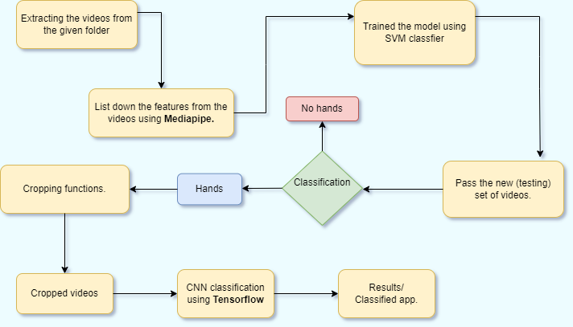
The Framework / Pipeline

Slide 3



Technologies Employed

Slide 4
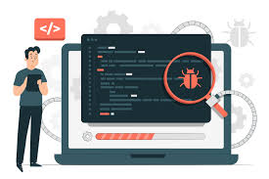
Initial Go through
Analysed and understood the pre-existing code.
Debugged and made changes for proper functionality.

Slide 5

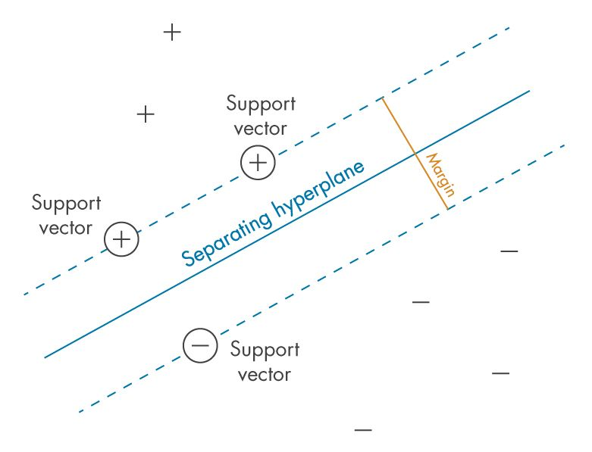
Machine Learning Models
Deployed various machine learning models to get best accuracy.
Made use of python library Pycaret .
Concluded SVM to be the best model .

Slide 6
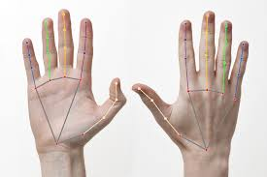
Hand Detection
Tested the existing media pipe model.
Explored and employed two YOLO models
for hands detection.
Achieved better accuracy in one of the YOLO model than Media pipe.

